Slide 1
Obesity-Related Comorbidities
Diabetes

Slide 2
Midterm
Average was 87%
If there is an calculation error let Sam know by email and she will arrange recalculating it.
If you think you deserve more points on a question
Write a brief note explaining why
Email Sam by next Thursday and give her your exam
Your entire exam will be re-graded

Slide 3
Obesity Related Conditions

Slide 4
Learning Objectives
Understand the relationships between obesity and all-cause mortality
Explain how age modified obesity-associated disease risks
Describe the normal physiology of glucose regulation, including the key roles of pancreas, muscle, liver and adipose tissues
Describe the progression of obesity-associated type 2 diabetes including the pathophysiology of these changes
Apply your knowledge of glucose homeostasis to explain how individuals may progress towards type 2 diabetes differently

Slide 5
Obesity and All-Cause Mortality
Similar effects for males
Increased risk at low and high BMI
More overall risk with younger
Adams KF, Schatzkin A, Harris TB, Kipnis V, Mouw T, Ballard-Barbash R, Hollenbeck A, Leitzmann MF. Overweight, Obesity, and Mortality in a Large Prospective Cohort of Persons 50 to 71 Years Old. N Engl J Med. 2006; 355: 763–78. doi: 10.1056/NEJMoa055643.

Slide 6
Obesity-Related Causes of Death
2002 data
Flegal KM, Graubard BI, Williamson DF, Gail MH. Cause-Specific Excess Deaths Associated With Underweight, Overweight, and Obesity. Jama. 2007; 298: 2028. doi: 10.1001/jama.298.17.2028.

Slide 7
Childhood obesity relative risks
Relative Risk of death from all causes compared to normal weight adolescents:
1.4-2.0X
Why might these risks be higher than adult onset obesity?
Disease | Adolescent Obesity
Adult Obesity | 1.4-2.8X
Cardiovascular Disease | 2.0-5.1X
Diabetes | 1.9-2.6X
NAFLD | 1.3X
Notes:
Prospective study in norwegian adolescents

Slide 8
Type 2 Diabetes and Obesity

Slide 9
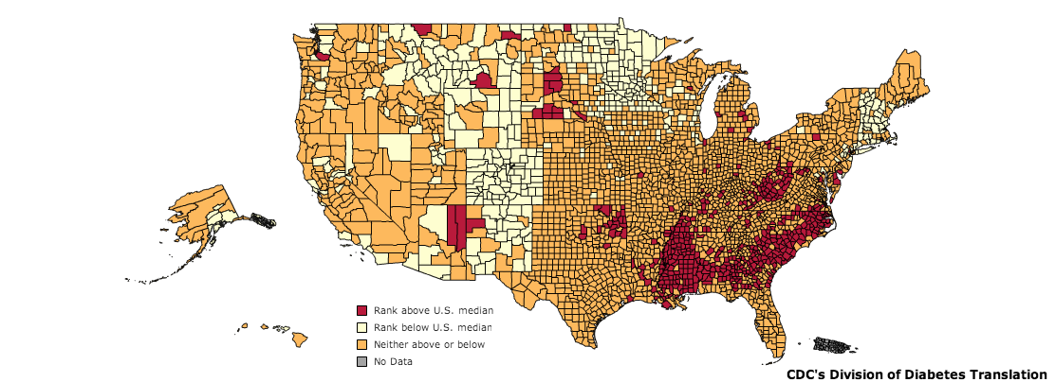
Diabetes in the United States
CDC, 2010
Notes:
As of 2011, diabetes affects 25.8 million people or 8.3% of the population. This includes approximately 7 million undiagnosed individuals. In addition to this, 79 million Americans over the age of 20 are estimated to be pre-diabetic. As of 2007, diabetes is estimated to cost $116 billion in direct and $58 billion in indirect costs [@CDC2011].
Diabetes is especially prevalent in this region. As shown in the map, there is a higher percentage of diabetics in the mid and deep south regions of the United States.

Slide 10
Glucose Regulation

Slide 11


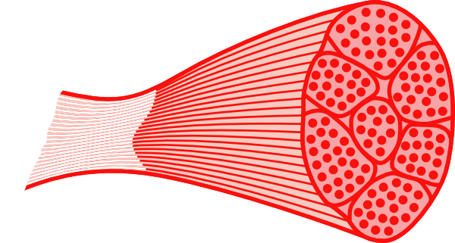
Regulation of Blood Glucose Levels
Gluconeogenesis
Disposal
Glucose Uptake
Glucose Storage
Glucose Utilization
Glucose Production
Glucose Uptake
Glucose Storage
and Utilization
Notes:
Ask for some examples of how glucose is stored, or how it is utilized

Slide 12
Insulin reduces blood glucose
Released by beta cells of the pancreas
Removes glucose from the blood by stimulating uptake in fat and muscle
Promotes fat storage
Stops glucose production (gluconeogenesis) in the liver

Slide 13
Obesity is associated with insulin resistance
Type 2 Diabetes is characterized by insulin resistance
Muscle cannot take up glucose (after a meal)
Liver does not stop producing glucose (while fed)
Insulin-Stimulated glucose uptake
DeFronzo RA. Lilly lecture 1987. The triumvirate: beta-cell, muscle, liver. A collusion responsible for NIDDM. Diabetes. 1988; 37: 667–87. doi: 10.2337/diab.37.6.667.

Slide 14
Obesity is associated with hyperinsulinemia
Nutritional overload
Protective insulin resistance
Tissues respond worse to insulin
More insulin is secreted
Tissues more desensitized
More insulin is secreted
Eventually beta cells cannot compensate

Slide 15
Obesity Related Progression of Diabetes

Slide 16
Pancreatic Beta-Cell Expansion
Some individuals become very insulin resistant but do not become diabetic
Excellent beta cell expansion
Very high insulin levels

Slide 17
Varied progression from obesity to T2D
What are some individual physiological factors that could alter the obesity-diabetes relationship?
Could convert glucose to fat less efficiently
How much fat they can store before developing peripheral insulin resistance
Beta cells could keep increasing insulin production for longer

Slide 18
Genetic Risk Factors for Obesity-Associated Diabetes

Slide 19
Diabetes as an emerging global health epidemic
442M in 2014
4 fold increase since 1980
Three reasons
Large populations
Increasing obesity
Higher risk at lower obesity

Slide 20
Ethnic Differences in the BMI-Diabetes Relationship
Chiu M, Austin PC, Manuel DG, Shah BR, Tu J V. Deriving ethnic-specific BMI cutoff points for assessing diabetes risk. Diabetes Care. 2011; 34: 1741–8. doi: 10.2337/dc10-2300.

Slide 21
Learning Objectives
Understand the relationships between obesity and all-cause mortality
Explain how age modified obesity-associated disease risks
Describe the normal physiology of glucose regulation, including the key roles of pancreas, muscle, liver and adipose tissues
Describe the progression of obesity-associated type 2 diabetes including the pathophysiology of these changes
Apply your knowledge of glucose homeostasis to explain how individuals may progress towards type 2 diabetes differently

